Slide 1
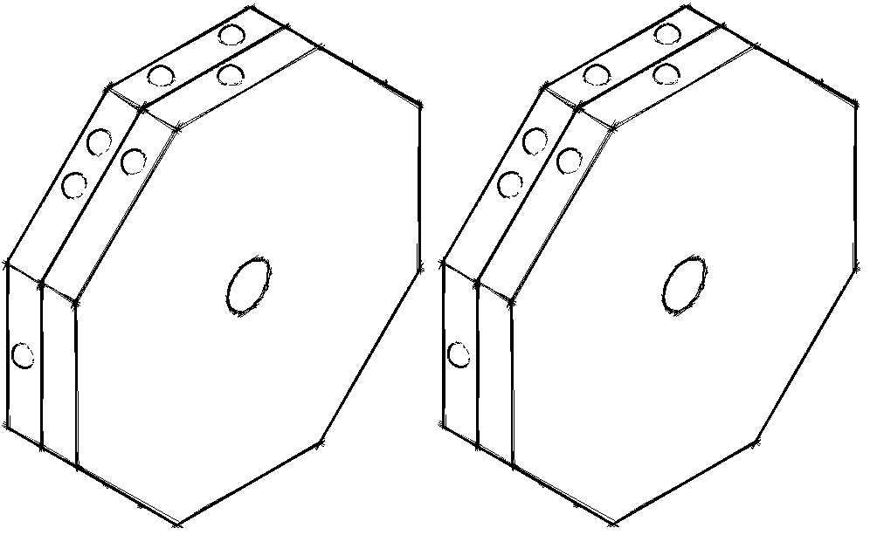
brailleb k
Refreshable Braille Display
December 3, 2015
Department of Electrical & Computer Engineering
Notes:
‹#›
spend a little time giving the audience a sense of what to expect. simple, cheap, help learn braille

Slide 2




Team
Richard Lam
EE, ‘16
Team Manager
Raveena Kothare
EE, ‘16
Steven Golonka
EE, ‘16
Faculty Advisor: Professor Dennis Goeckel
Department of Electrical & Computer Engineering
Notes:
‹#›

Slide 3
Introduction
Braillebook: A low-cost, quickly refreshing, dynamic Braille display
In a world of recorded sound, text-to-voice translators and voice-activated software, the withering of Braille might not be thought to matter much. But it does. Only a quarter of blind Americans of working age actually have jobs, and it is surely no coincidence that almost all of them can read Braille. As Brian MacDonald, president of the National Braille Press, in Boston, puts it, It is one thing to listen to a newspaper article being read aloud, but there’s no way you can understand a complex calculus or chemistry equation just by listening.” ¹
-The Economist
Department of Electrical & Computer Engineering
[1] http://www.economist.com/news/science-and-technology/21654564-tablet- computers-blind-people-are-development-reading-lessons
Notes:
‹#›
Talk about how it would work- text file is loaded onto device, row of characters is displayed, user presses buttons to go to next/previous line
Can be used in workplace or recreationally
Include economist quote

Slide 4
Motivation
Braille literacy is positively correlated with education, employment, and income¹
74% of working-age blind people are unemployed¹
Depend on disability income benefits
Today, 10% of blind children are taught Braille²
Compare to 50% in the 1950s
Braille texts are expensive
Costs several times more than ordinary books
Electronic refreshable Braille displays cost $2000-$8000³
Department of Electrical & Computer Engineering
[1] https://www.nbp.org/ic/nbp/braille/needforbraille.html
[2]http://www.economist.com/news/international/21595475-new-tech nology-could-save-writing-system-blind-joining-dots
[3]http://www.bbc.com/news/technology-27243376
Notes:
‹#›

Slide 5
braillebook: A Learning Tool
User will be able to read the displayed line of Braille and compare it to the output of the text-to-speech output
Market competition:
BraillePen 12 Touch: 12 cell display, bluetooth keyboard, compatible with text to speech software, $1150
Smart Beetle 14-Cell Braille Display: compatible with popular screen reader software, audio prompt for menu, $1200
Brailliant BI 40: 40 cell display, compatible with screen reader software, $2995
Department of Electrical & Computer Engineering
Notes:
talk about braillebook as a learning tool

Slide 6
Requirements - User
Can load text files to device via USB 2.0 to computer
Powered by standard wall outlet
No larger than 50x15x12 cm
Device controls are easy to locate for a blind person
Power ON/OFF
Select loaded text file
Shift NEXT/PREVIOUS line
Displays at least 20 Braille cells in 1 line
Possibility of implementing multiple lines
Line refreshes in no more than 5 seconds
Costs <$400
Department of Electrical & Computer Engineering
Notes:
‹#›

Slide 7
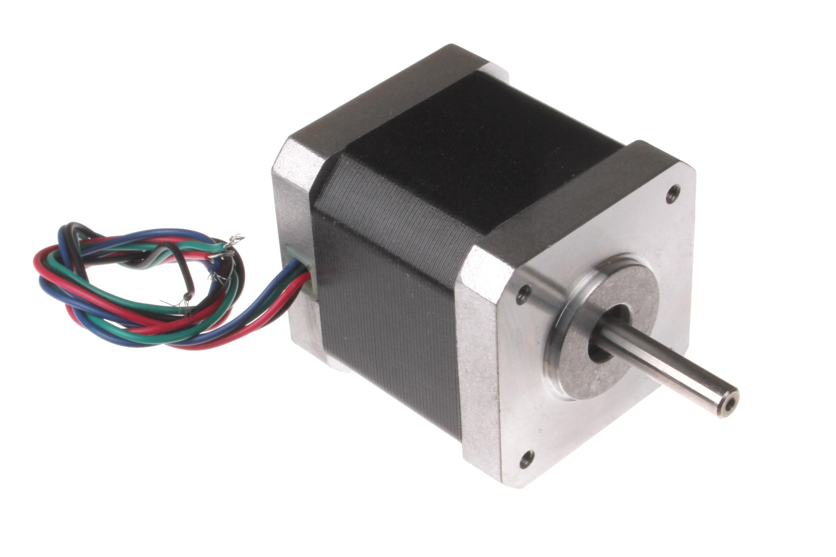
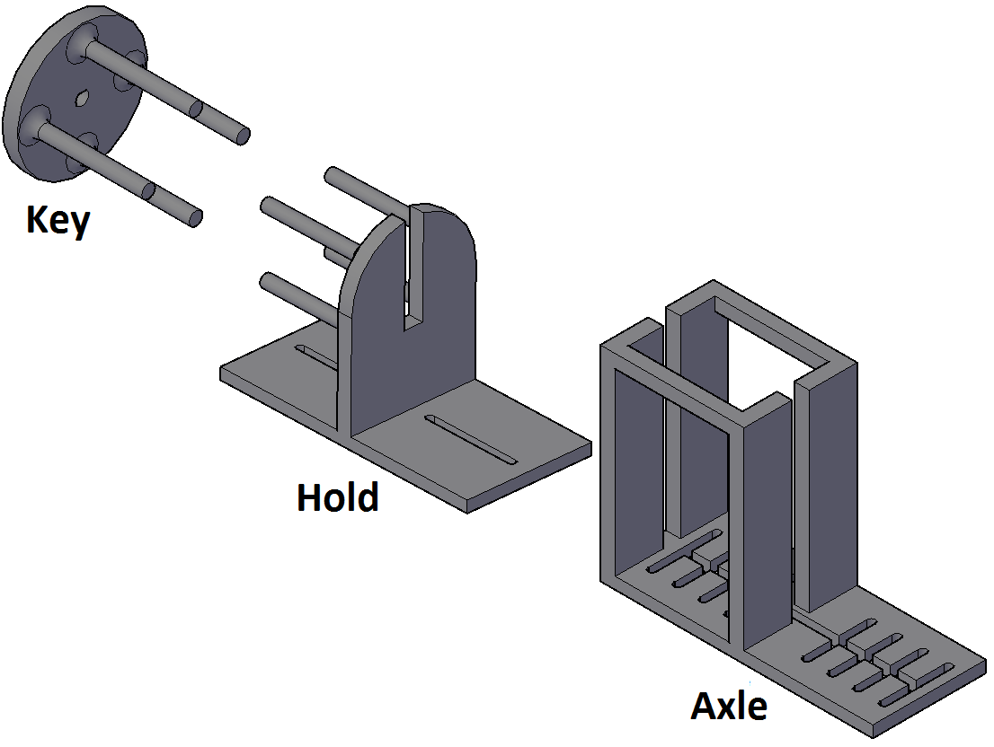

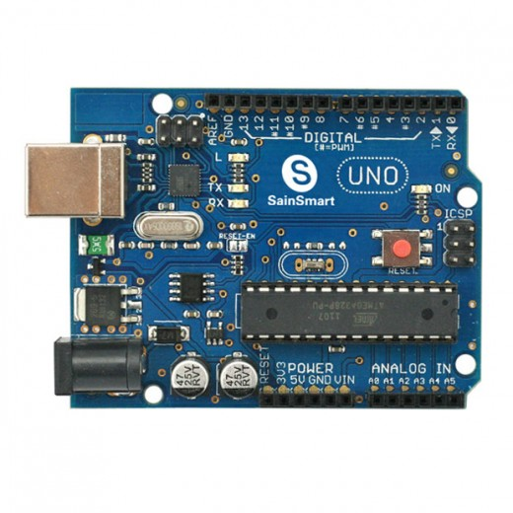
Chosen Design - Octagonal Wheels
Mechanical Display
Computer
Arduino
Motors
Department of Electrical & Computer Engineering
Notes:
give overview of system
add octagonal wheel

Slide 8
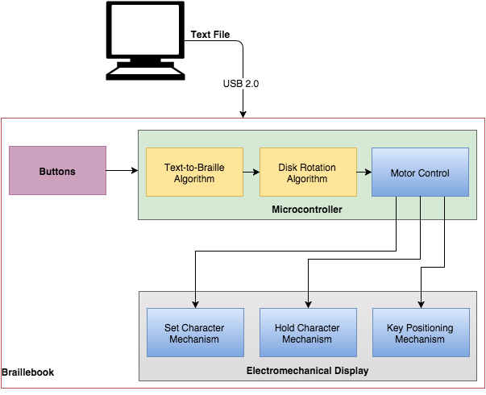
Proposed Block Diagram
Department of Electrical & Computer Engineering

Slide 9

Revised Block Diagram
Department of Electrical & Computer Engineering
Notes:
no key, no hold talk. mention one less motor?

Slide 10
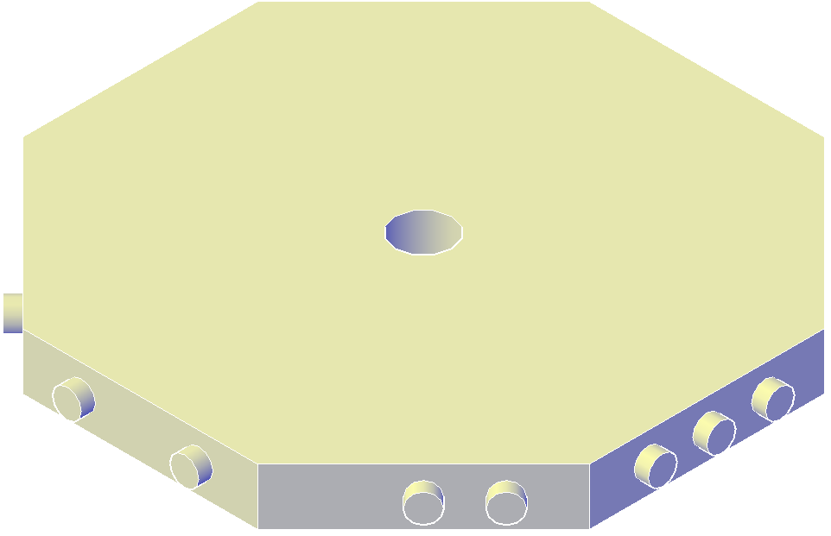
Chosen Design - Octagonal Wheels
Simple way to change characters
Spin from one position to the next
Octagonal disks are supported by a stationary axle
Key mechanism of linear and rotational motion, adjusts each disk sequentially
Sliding Key Method
Set Character mechanism engages and disengages disks one at a time
Hold mechanism moves along with set character mechanism on opposite end of display
Each disk is always engaged by one mechanism
Department of Electrical & Computer Engineering
Notes:
‹#›

Slide 11
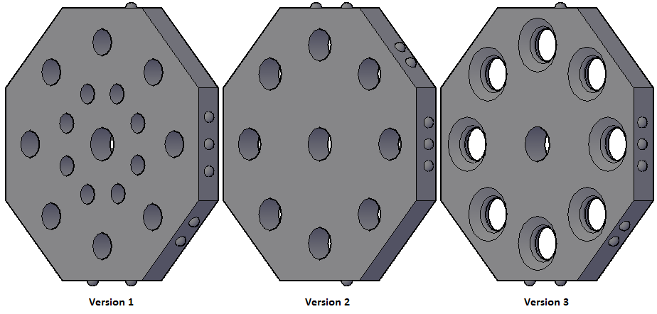
Octagonal Wheels
put pics of original face and donut hole face
Department of Electrical & Computer Engineering
Notes:
talk about version 3 benefits

Slide 12
Key, Hold, and Axle
Department of Electrical & Computer Engineering

Slide 13
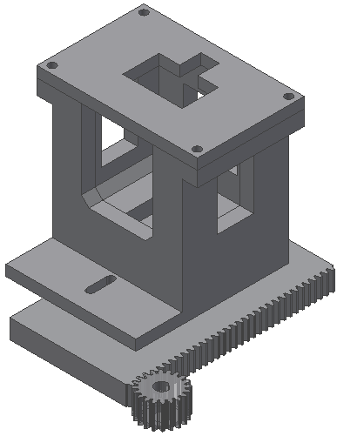
Case Mounted Rack and Pinion
Department of Electrical & Computer Engineering

Slide 14
Disk Rotation Algorithm – Explained
Setting characters from left to right
Algorithm calculates number of rotations for each disk
Rotation of a given disk affects all disks to the left of it
Final positions of disks are achieved once rotation of rightmost disk is complete
Example with four sided disk below:
Orient all dots at top
Department of Electrical & Computer Engineering
Notes:
‹#›

Slide 15
Disk Rotation Algorithm – Explained
Setting characters from left to right
Algorithm calculates number of rotations for each disk
Rotation of a given disk affects all disks to the left of it
Final positions of disks are achieved once rotation of rightmost disk is complete
Example with four sided disk below:
Orient all dots at top
Department of Electrical & Computer Engineering
Notes:
‹#›

Slide 16
Disk Rotation Algorithm – Explained
Setting characters from left to right
Algorithm calculates number of rotations for each disk
Rotation of a given disk affects all disks to the left of it
Final positions of disks are achieved once rotation of rightmost disk is complete
Example with four sided disk below:
Orient all dots at top
Department of Electrical & Computer Engineering
Notes:
‹#›

Slide 17
Disk Rotation Algorithm – Explained
Setting characters from left to right
Algorithm calculates number of rotations for each disk
Rotation of a given disk affects all disks to the left of it
Final positions of disks are achieved once rotation of rightmost disk is complete
Example with four sided disk below:
Orient all dots at top
Department of Electrical & Computer Engineering
Notes:
‹#›

Slide 18
Disk Rotation Algorithm – Explained
Setting characters from left to right
Algorithm calculates number of rotations for each disk
Rotation of a given disk affects all disks to the left of it
Final positions of disks are achieved once rotation of rightmost disk is complete
Example with four sided disk below:
Orient all dots at top
Department of Electrical & Computer Engineering
Notes:
‹#›

Slide 19
Disk Rotation Algorithm – Explained
Setting characters from left to right
Algorithm calculates number of rotations for each disk
Rotation of a given disk affects all disks to the left of it
Final positions of disks are achieved once rotation of rightmost disk is complete
Example with four sided disk below:
Orient all dots at top
Department of Electrical & Computer Engineering
Notes:
‹#›

Slide 20
Disk Rotation Algorithm – Explained
Setting characters from left to right
Algorithm calculates number of rotations for each disk
Rotation of a given disk affects all disks to the left of it
Final positions of disks are achieved once rotation of rightmost disk is complete
Example with four sided disk below:
Orient all dots at top
Department of Electrical & Computer Engineering
Notes:
‹#›

Slide 21
Disk Rotation Algorithm – Explained
Setting characters from left to right
Algorithm calculates number of rotations for each disk
Rotation of a given disk affects all disks to the left of it
Final positions of disks are achieved once rotation of rightmost disk is complete
Example with four sided disk below:
Orient all dots at top
Department of Electrical & Computer Engineering
Notes:
‹#›

Slide 22
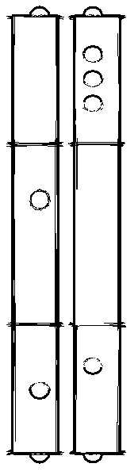
Promised MDR Deliverables
Produce open-box prototype of Axle and Key design
Not scaled to size specifications
Set 1 Braille cell
Control 2 octagonal disks
Control motors with microcontroller
Device is not responsive in real-time
Department of Electrical & Computer Engineering
Notes:
‹#›
step through these so that they got checked off one at a time and change improvements

Slide 23

MDR Accomplishments
Produce open-box prototype of Axle and Key design
Not scaled to size specifications
Set 1 Braille cell
Control 2 octagonal disks
Control motors with microcontroller
Device is not responsive in real-time
Department of Electrical & Computer Engineering

Slide 24
MDR Accomplishments
Produce open-box prototype of Axle and Key design
Not scaled to size specifications
Set 1 Braille cell
Control 2 octagonal disks
Control motors with microcontroller
Device is not responsive in real-time
Department of Electrical & Computer Engineering

Slide 25
MDR Accomplishments
Produce open-box prototype of Axle and Key design
Not scaled to size specifications
Set 3 Braille cells
Control 6 octagonal disks
Control motors with microcontroller
Device is not responsive in real-time
Department of Electrical & Computer Engineering

Slide 26
MDR Accomplishments
Produce open-box prototype of Axle and Key design
Not scaled to size specifications
Set 3 Braille cells
Control 6 octagonal disks
Control motors with microcontroller
Device is not responsive in real-time
Department of Electrical & Computer Engineering

Slide 27
MDR Accomplishments
Produce open-box prototype of Axle and Key design
Not scaled to size specifications
Set 3 Braille cells
Control 6 octagonal disks
Control motors with microcontroller
Device is capable of producing output based on user input from computer
Demonstrates functionality of algorithm
Department of Electrical & Computer Engineering

Slide 28
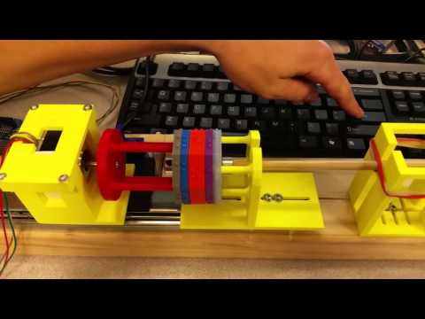
MDR Demo Preview
Department of Electrical & Computer Engineering

Slide 29
System Requirements
Device must have 7 buttons for:
ON/OFF, Menu, Yes, No, Read Line, Next Line, Previous Line
Device must play audio of displayed line when prompted
Adjustable volume and headphone jack
Rotational motor must be capable of moving 40 disks
Each line must refresh in about 5 seconds
Entire device must be smaller than 50x15x12 cm³
Device must be able to hold 250 pages of text
1 page ≈ 4,000 characters (single-spaced)
250 pages ≈ 1 MB
Device will be powered by wall outlet
Must cost less than $400
Department of Electrical & Computer Engineering

Slide 30
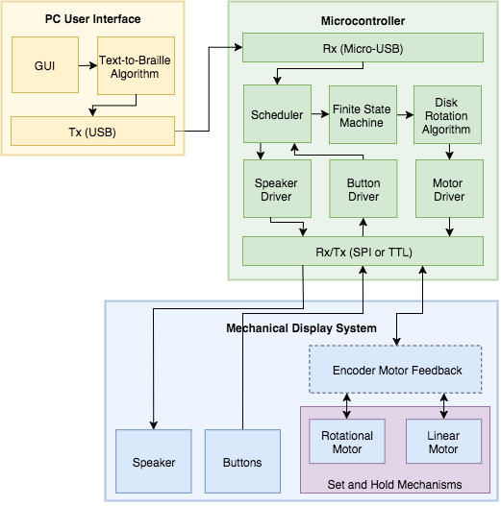
System Block Diagram
Department of Electrical & Computer Engineering

Slide 31
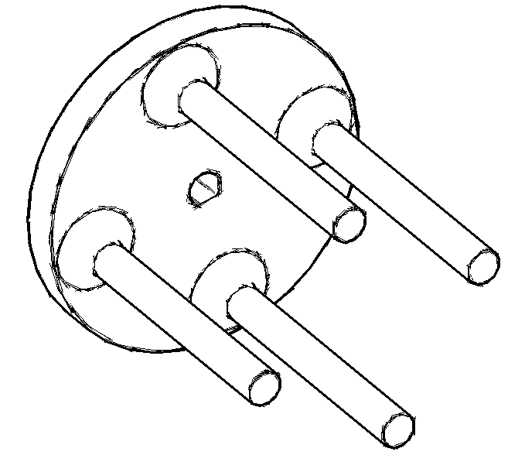
Rotational Motor
Prototype has accuracy and precision, but low speed
Higher speed is necessary to meet spec. of 5 seconds for 40 disks
Minimum of 400 rpm → 3 seconds to rotate 40 disks
Allows 2 seconds for linear motion and buffer
Sufficient torque to rotate and hold 40 disks
Motor and driver selection will determine microcontroller selection
Department of Electrical & Computer Engineering
Notes:
talk about how this is realistic

Slide 32
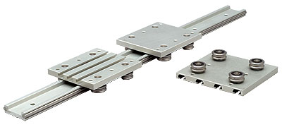
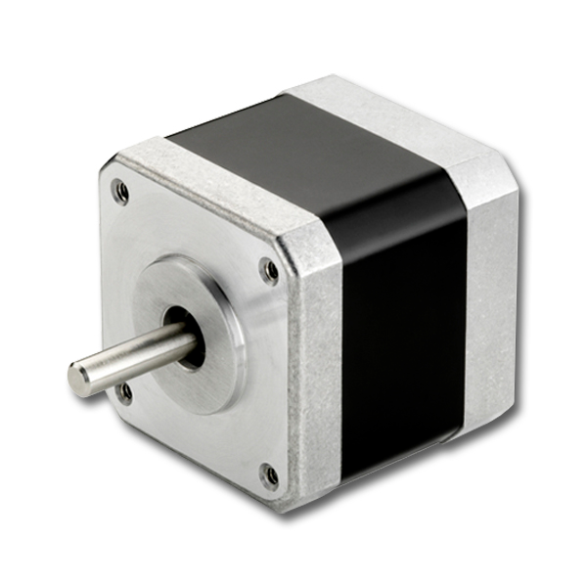
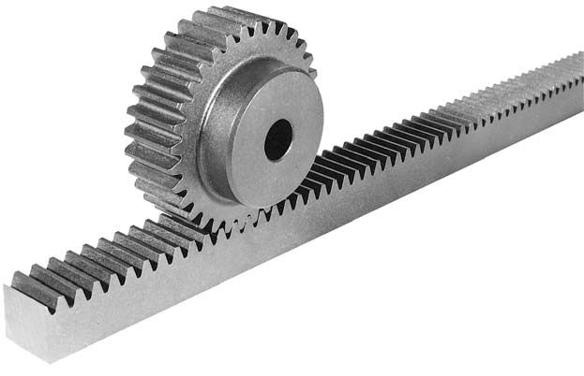
Linear Motion
Linear rail holds key and hold mechanism
Rack and pinion attached to carriage on the rail
Stepper motor drives the device
Minimum of 200 rpm to achieve 1 second of travel through the display
Rack & Pinion
Linear Rail
Stepper Motor
Department of Electrical & Computer Engineering

Slide 33
Microcontroller
Requires at least 10 I/O pins
7 buttons, 2 motors, 1 speake
Capable of outputting PWM signal
Requires UART and SPI
5V USB loading and debugging connection
Current options (32-bit ARM Cortex):
STM32F0 Series: good real-time performance with peripherals
mbed LPC1768: good for prototyping but lacks technical support
Department of Electrical & Computer Engineering

Slide 34

GUI
Simple Windows application
Allows user to load text files onto the device
Back-end will execute the Text-to-Braille algorithm
Department of Electrical & Computer Engineering

Slide 35
CDR Deliverables
Fully functional electromechanical display
20 characters
7 buttons
On/Off, Menu, Yes, No, Previous Line, Next Line, Read Line
Functional GUI
Can take in text file input and load corresponding display code onto device
Device meets size requirement
No larger than 50x15x12 cm
Device stores information for 1 text file
Will not be fully packaged
Department of Electrical & Computer Engineering
Notes:
Ask Prof. Goeckel- How should we mention that we want our target audience of this product to be people who are learning braille? this is a

Slide 36
Team Members’ Responsibilities
PC User Interface
Microcontroller
Motor Drivers & Automation
Mechanical System
Department of Electrical & Computer Engineering

Slide 37
Team Members’ Responsibilities
Richard
PC User Interface
Raveena
Microcontroller
Steve
Motor Drivers & Automation
Richard
Mechanical System
Department of Electrical & Computer Engineering

Slide 38
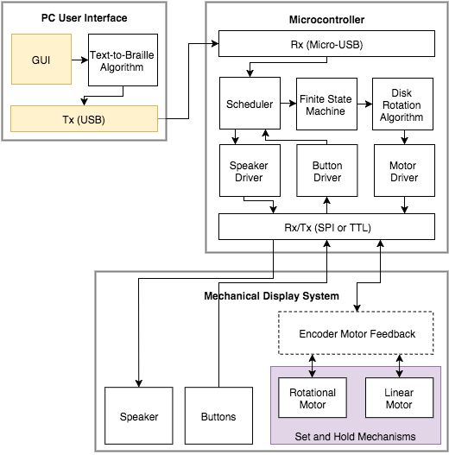
Team Members’ Responsibilities - Richard
Department of Electrical & Computer Engineering
Notes:
change the text-to-braille algorithm block to steve

Slide 39
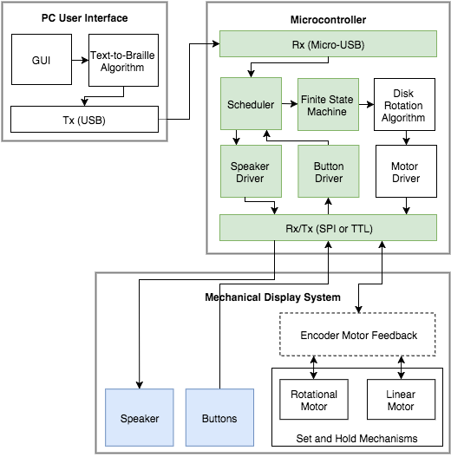
Team Members’ Responsibilities - Raveena
Department of Electrical & Computer Engineering
Notes:
add FSM block

Slide 40
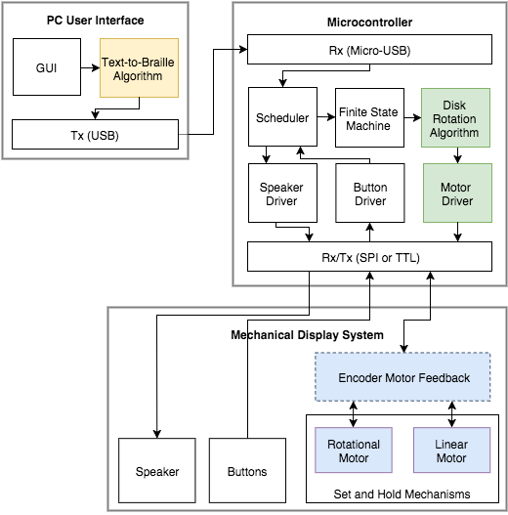
Team Members’ Responsibilities - Steve
Department of Electrical & Computer Engineering

Slide 41
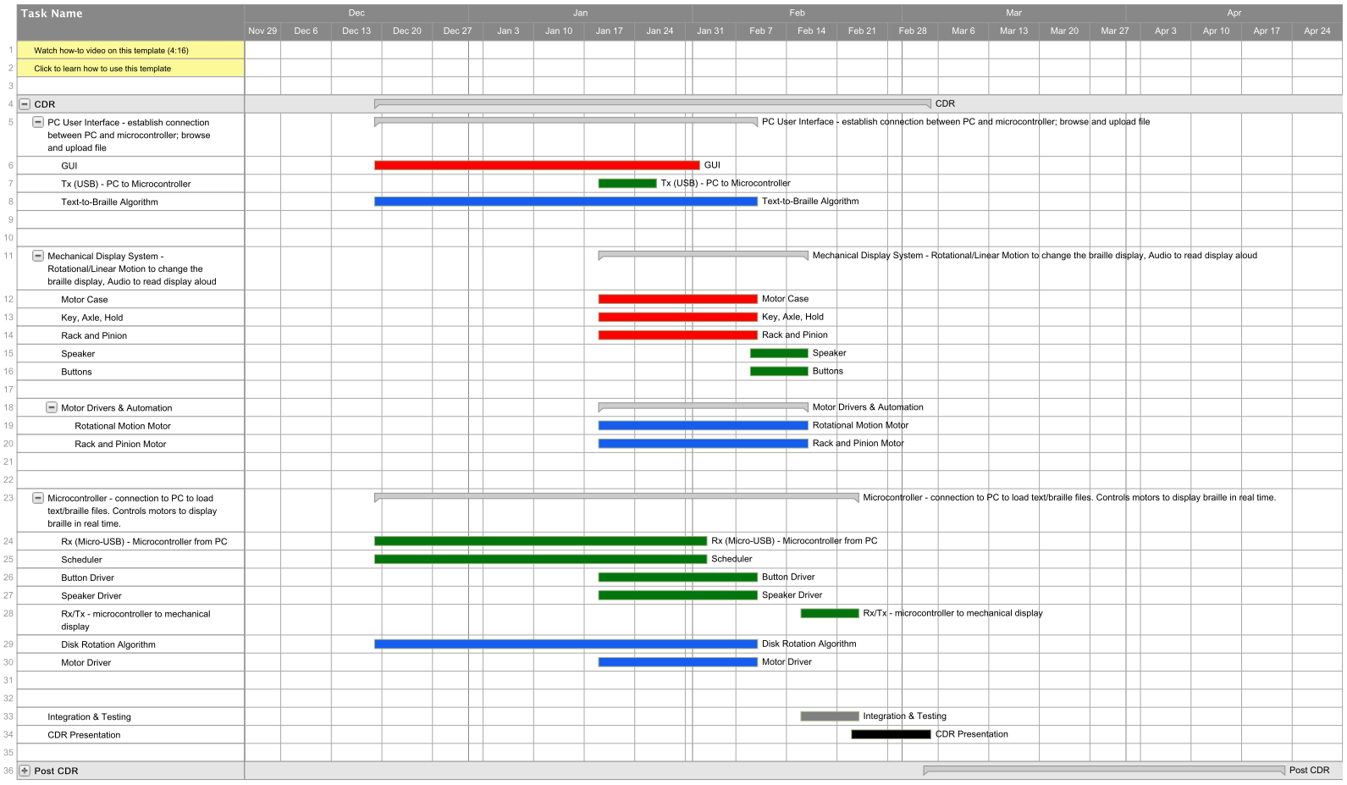

Gantt Chart
Department of Electrical & Computer Engineering

Slide 42
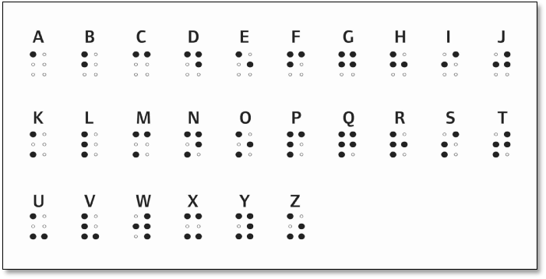

Department of Electrical & Computer Engineering
Notes:
‹#›

Slide 43
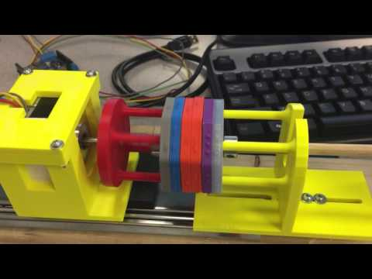
Full Demo Video
Department of Electrical & Computer Engineering

Slide 44

Questions & Discussion
Department of Electrical & Computer Engineering
Notes:
‹#›

Slide 45

Department of Electrical & Computer Engineering
Notes:
‹#›

